Slide 1
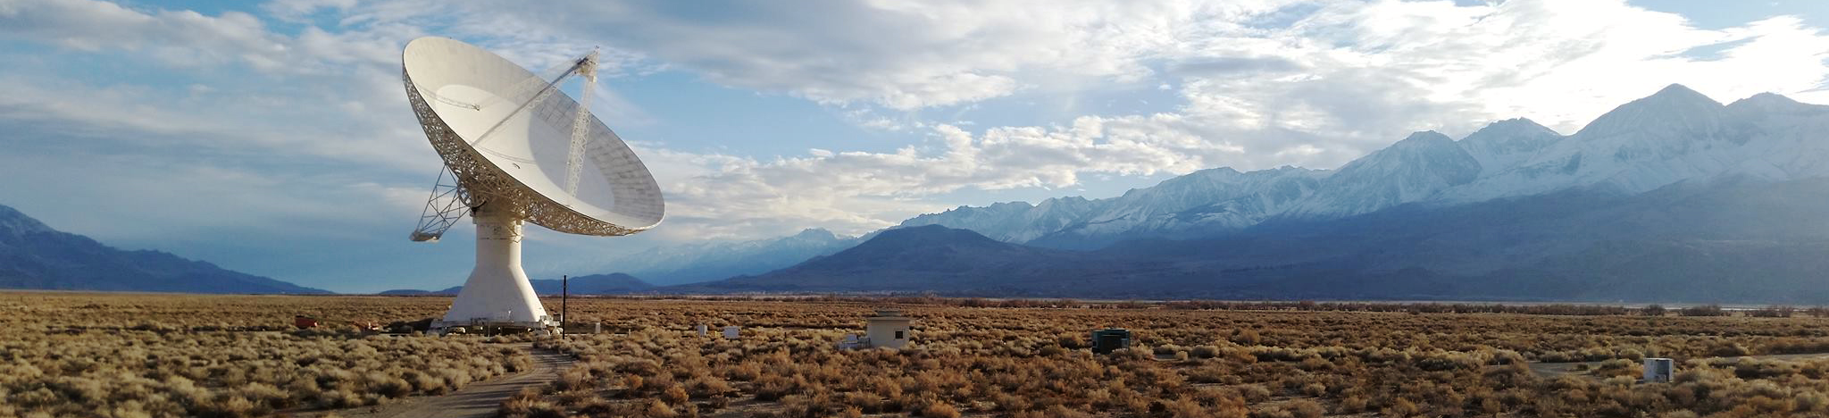


Milliarcsecond Core Size Dependence of the Radio Variability of Blazars
2022 IAU Symposia 375:
The multimessenger chakra of blazar jets
2022/12/6 @Kathmandu, Nepal
Po-Chih Hsu
Graduate Institute of Astronomy, National Central University, Taoyuan, Taiwan
Institute of Astronomy and Astrophysics, Academia Sinica, Taipei, Taiwan
Jun Yi Koay (ASIAA), Satoki Matsushita (ASIAA), Talvikki Hovatta (FINCA/Aalto),
Sebastian Kiehlmann (Uni of Crete), Walter Max-moerbeck (U de Chile), Tim Pearson (Caltech),
Anthony Readhead (Caltech), Rodrigo Reeves (U de Conception), Harish Vedanthan (ASTRON)

Slide 2
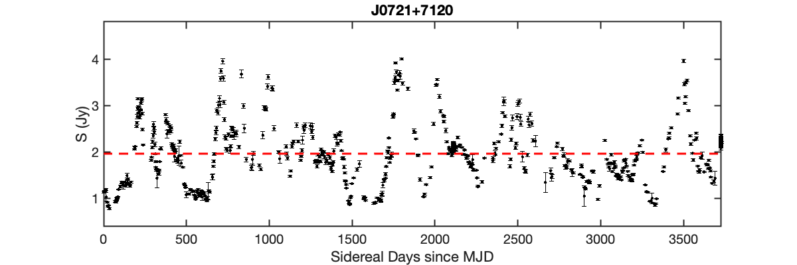
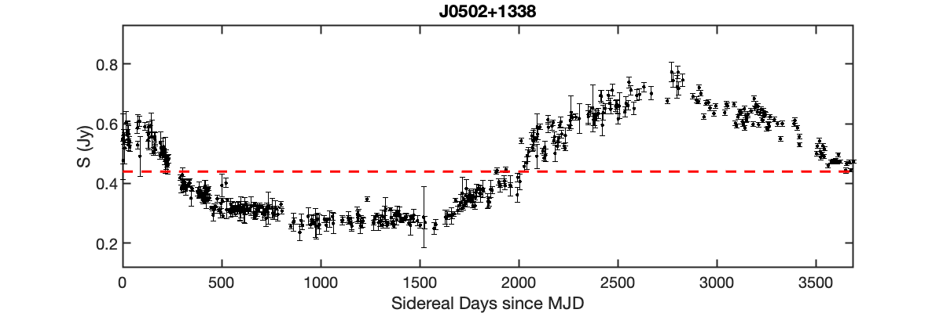
Introduction – Motivation and Objective
Study on AGN variability requires a lot of telescope time
In previous radio variability study (Lovell et al., 2008)
→ Few sources for a long time and good sampling
→ Lots of sources for a short time and poor sampling
10 years
10 years
Investigate the dependence between variability amplitudes and timescales with milli-arcsecond core sizes at multiple frequencies
Notes:
OVRO blazar monitoring program
left panel is a rapid variation source
right panel is a slow variable source, it only occur a cycle of variation during the observation

Slide 3
Introduction - Data
15 GHz OVRO Blazar Monitoring Program (Richards et al., 2011&2014)
1158/1500 radio-selected blazars were used
VLBA Core Size Measurements (Pushkarev and Kovalev 2015, Koryukova et al., 2022)
Multifrequencies angular core sizes (1, 2, 5, 8, 15, 24, 43, 86 GHz)
~9000 sources (1053 sources overlap in 15 GHz)
Core sizes were obtained from Gaussian fitting
Median value of core sizes were taken measured in many epochs
Redshift
Pushkarev & Kovalev (2015) & Richards et al. (2014)
Notes:
We used core sizes data from Pushkarev and Kovalev 2015 in the beginning, but updated the dataset to Koryukova et al., 2022, increasing 3 times of source number

Slide 4
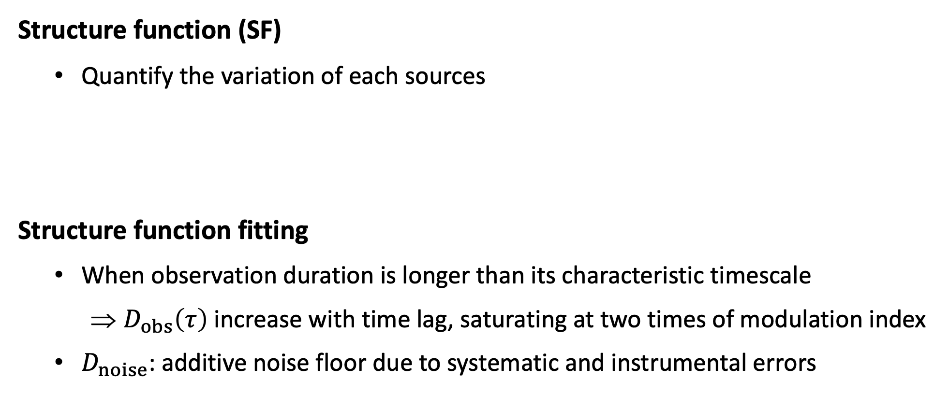
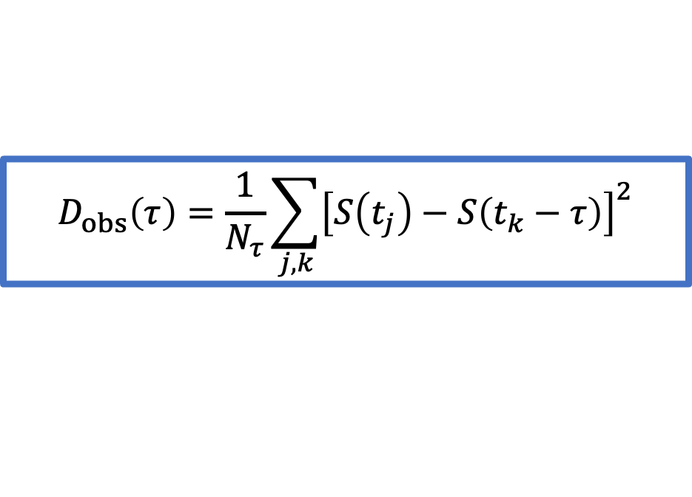

Analysis
$$D_{obs}\left(τ\right)=\frac{1}{N_{τ}}\sum_{j,k}{{\left[S\left(t_{j}\right)−S\left(t_{k}−τ\right)\right]}^{2}}$$
Structure function (SF)
Quantify the variation of each sources
Structure function fitting
When observation duration is longer than its characteristic timescale
$D_{obs}\left(τ\right)$ increase with time lag, saturating at two times of modulation index
$D_{noise}$: additive noise floor due to systematic and instrumental errors
$$D_{mod}\left(τ\right)=2m^{2}\left(\frac{τ}{τ+τ_{char}}\right)+D_{noise}$$
Notes:
SF fitting: Assuming a random stochastic process
SF amplitude or variability amplitude
How strong did it vary

Slide 5
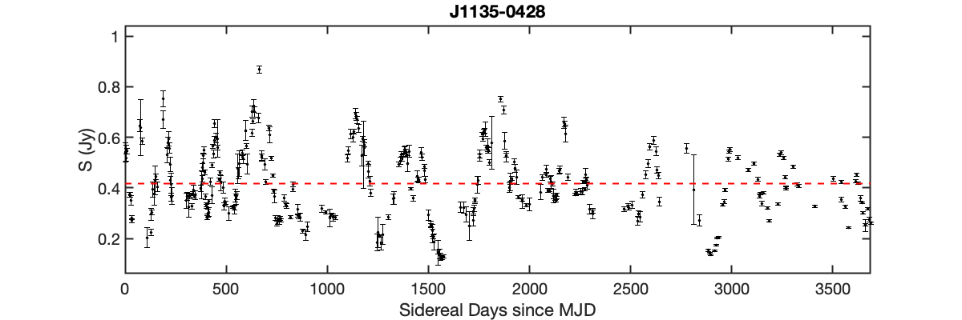
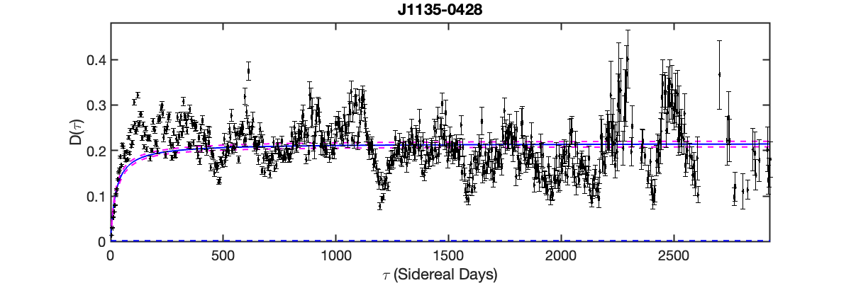
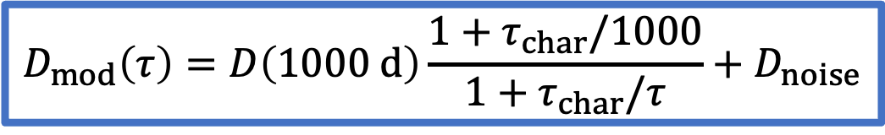

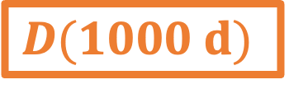
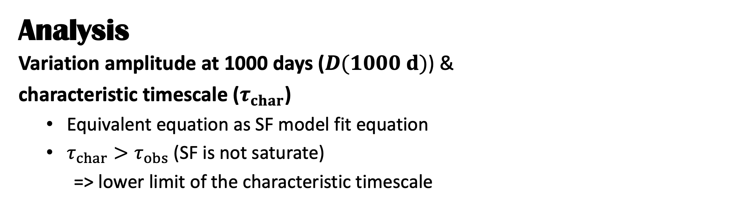
$$D_{mod}\left(τ\right)=D\left(1000 d\right)\frac{1+τ_{char}/1000}{1+τ_{char}/τ}+D_{noise}$$
Analysis
Variation amplitude at 1000 days ($D(1000 d)$) &
characteristic timescale ($τ_{char}$)
Equivalent equation as SF model fit equation
$τ_{char}>τ_{obs}$ (SF is not saturate)
=> lower limit of the characteristic timescale
Light curve
SF and SF fitting
$$D(1000 d)$$
$$τ_{char}$$
Notes:
blue solid line is SF fitting line
pink dashed lines are 95% confidence interval of SF fitting line
D(1000d) is because time lag is sufficiently large such that the SF already saturates in alarge number of sources,
but not too large such that the SF amplitudes are dominated by measurement uncertainties
tau_char is the half maximum of the saturation

Slide 6
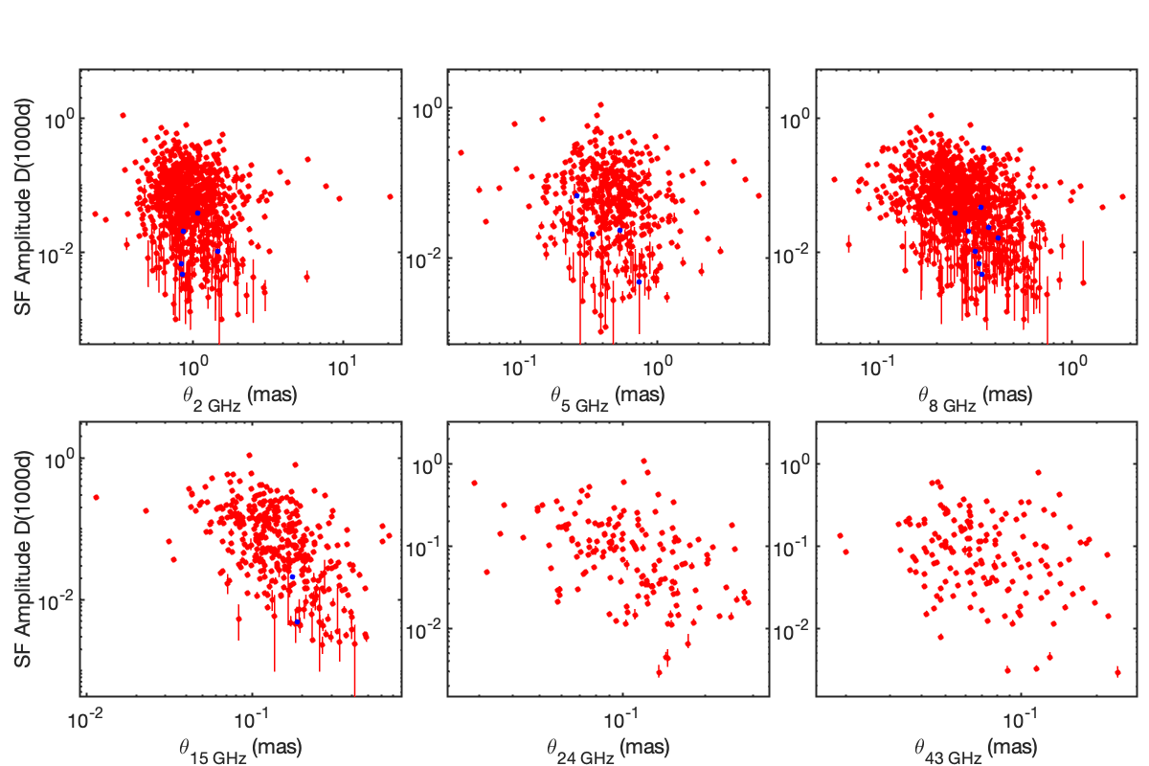
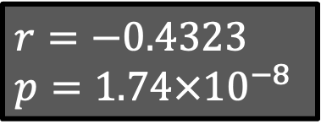
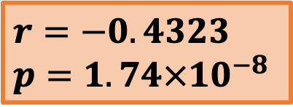
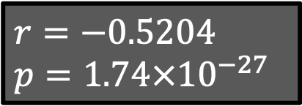
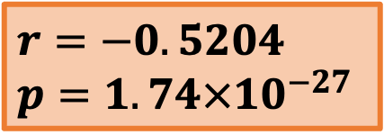
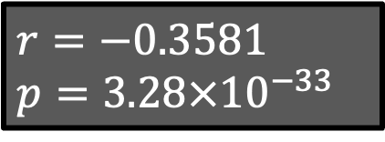
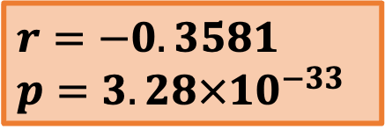
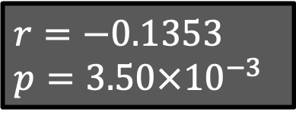
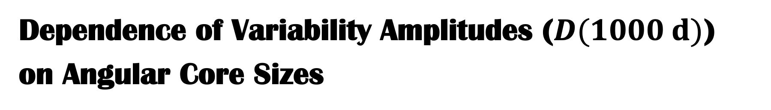
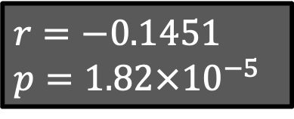
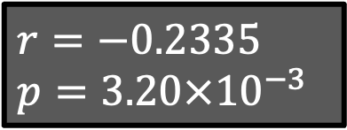
Dependence of Variability Amplitudes ($D(1000 d)$)
on Angular Core Sizes
$$r=−0.1451$$
$$p=1.82×{10}^{−5}$$
$$r=−0.1353$$
$$p=3.50×{10}^{−3}$$
$$r=−0.3581$$
$$p=3.28×{10}^{−33}$$
$$r=−0.3581$$
$$p=3.28×{10}^{−33}$$
$$r=−0.4323$$
$$p=1.74×{10}^{−8}$$
$$r=−0.5204$$
$$p=1.74×{10}^{−27}$$
$$r=−0.4323$$
$$p=1.74×{10}^{−8}$$
$$r=−0.2335$$
$$p=3.20×{10}^{−3}$$
$$r=−0.5204$$
$$p=1.74×{10}^{−27}$$
Notes:
we classified D(1000) greater than the median value as strong variables
we see the strongest correlation in 15 GHz, because D(1000 d) were measured in 15 GHz, as well
also, due to core size – frequency relationship, in other frequencies we can also see correlation

Slide 7
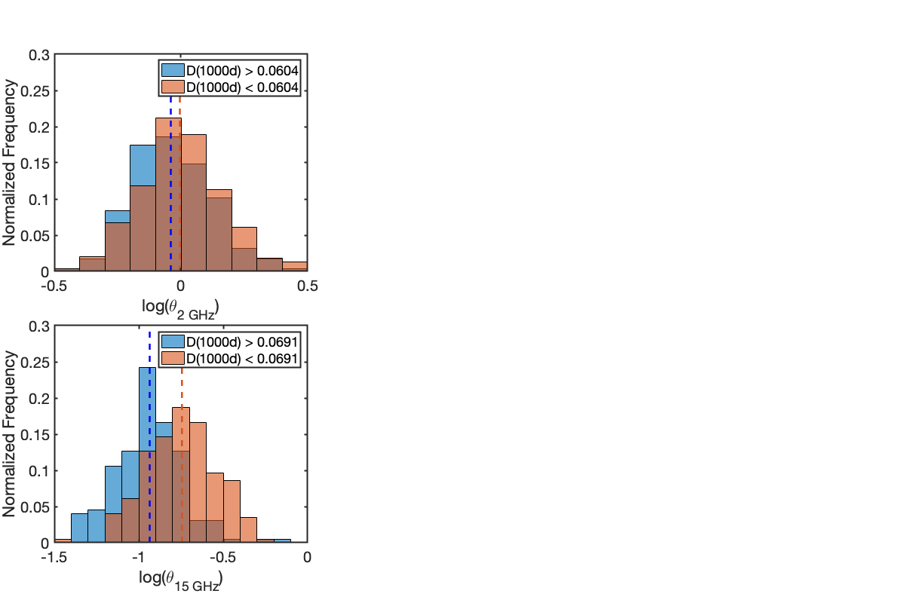
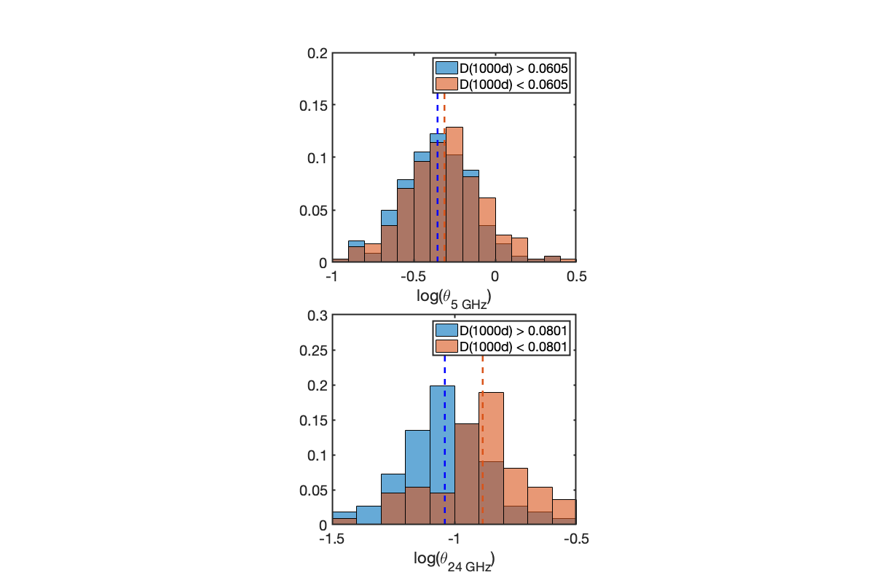
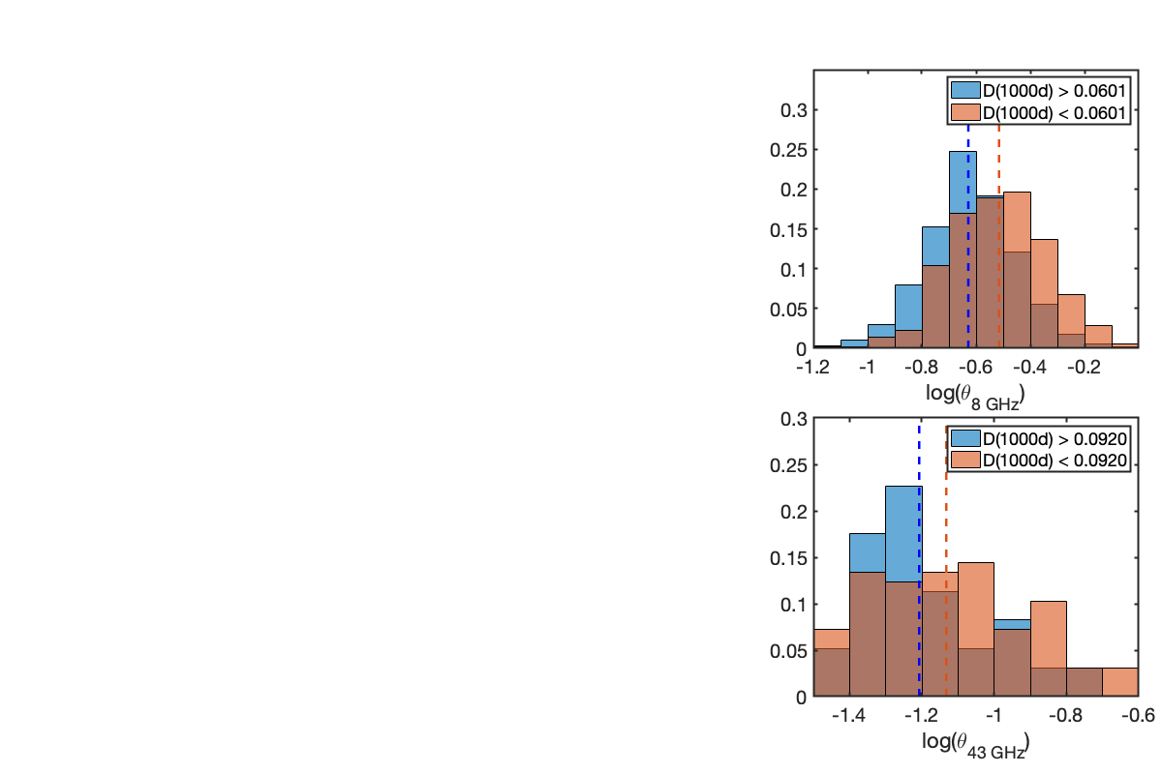
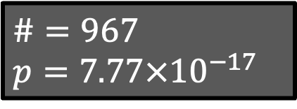
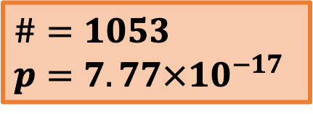
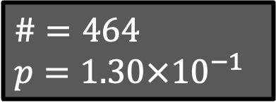
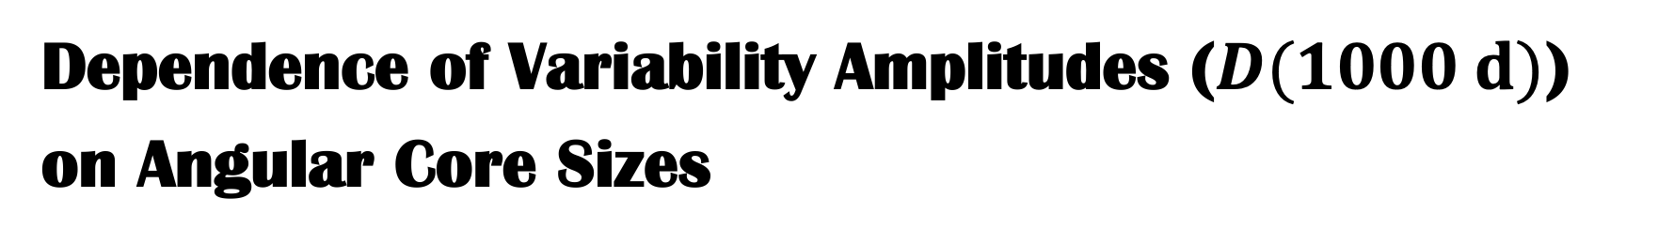
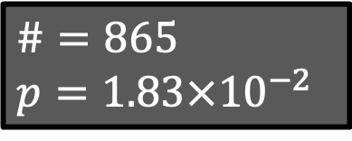
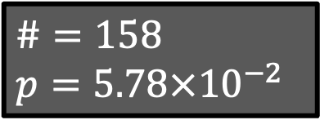
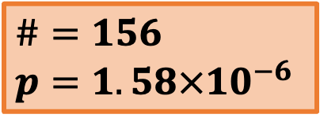
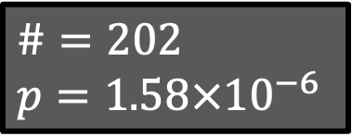
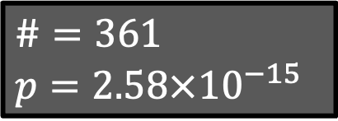
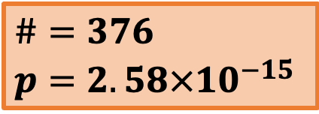
Dependence of Variability Amplitudes ($D(1000 d)$)
on Angular Core Sizes
$$\#=865$$
$$p=1.83×{10}^{−2}$$
$$\#=464$$
$$p=1.30×{10}^{−1}$$
$$\#=1053$$
$$p=7.77×{10}^{−17}$$
$$\#=967$$
$$p=7.77×{10}^{−17}$$
$$\#=376$$
$$p=2.58×{10}^{−15}$$
$$\#=361$$
$$p=2.58×{10}^{−15}$$
$$\#=156$$
$$p=1.58×{10}^{−6}$$
$$\#=202$$
$$p=1.58×{10}^{−6}$$
$$\#=158$$
$$p=5.78×{10}^{−2}$$
Notes:
we classified D(1000) greater than the median value as strong variables
strong variables have significantly smaller core sizes than weak variables

Slide 8
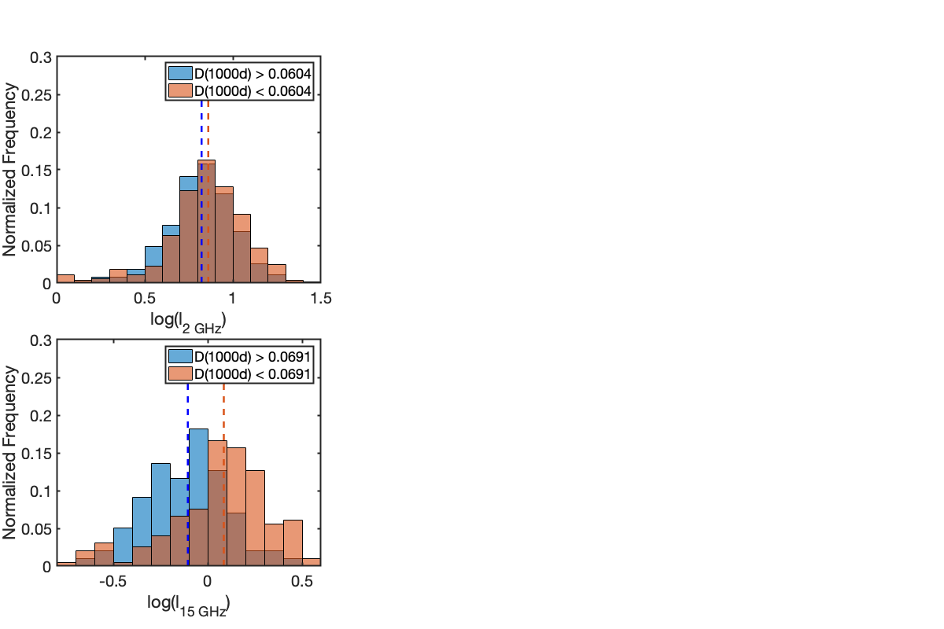
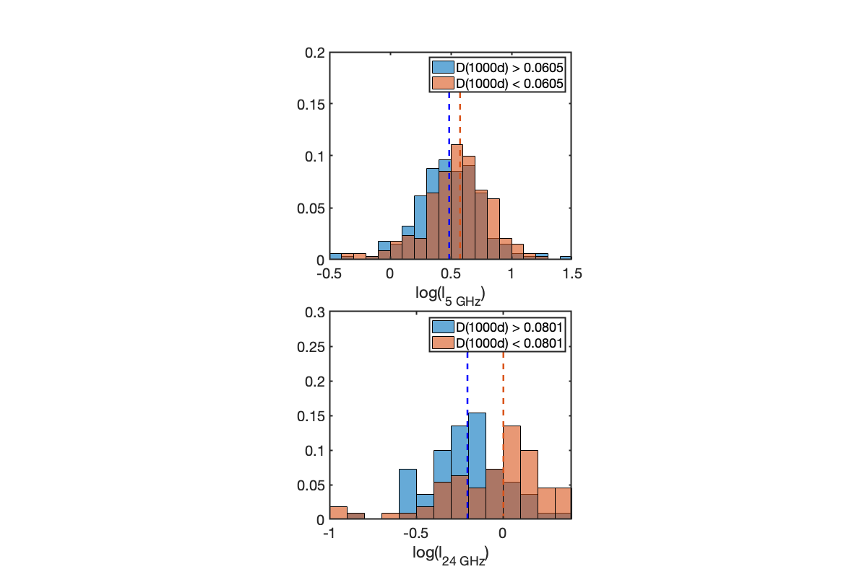
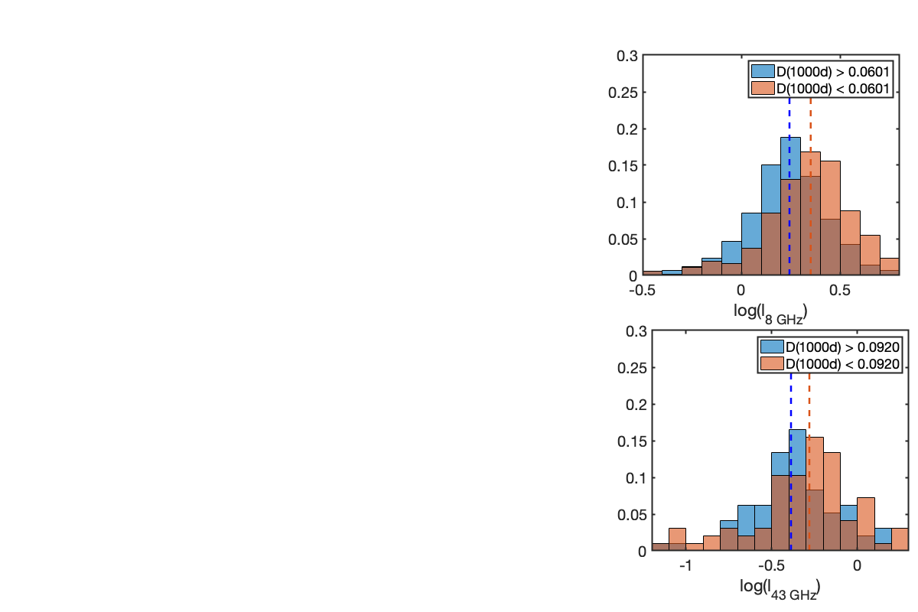
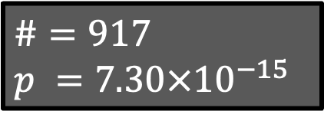
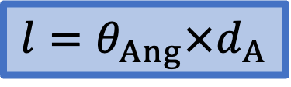
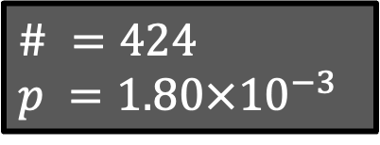
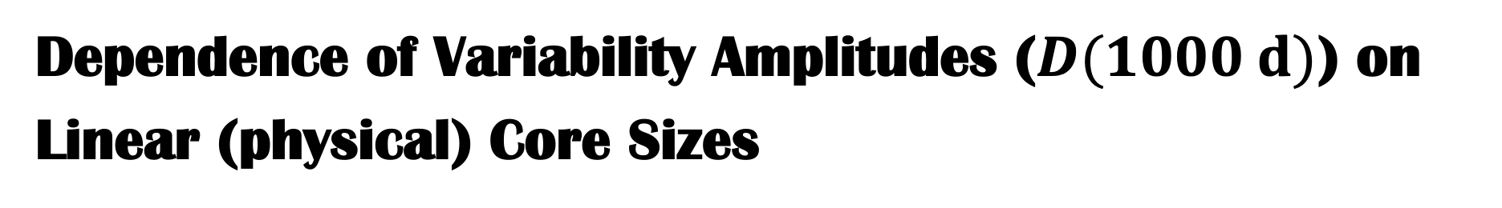
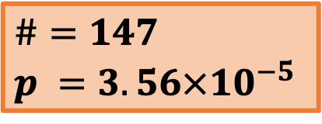
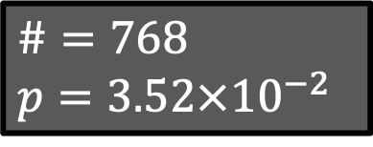
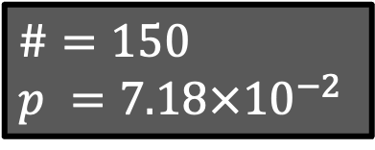
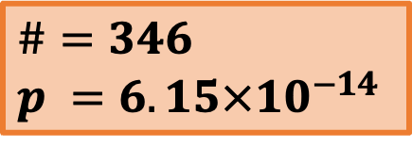
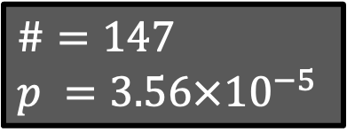
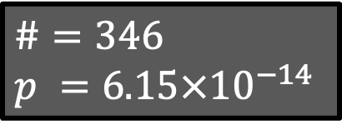
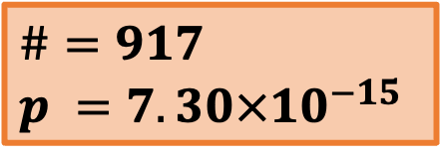
Dependence of Variability Amplitudes ($D(1000 d)$) on
Linear (physical) Core Sizes
$$l=θ_{Ang}×d_{A}$$
$$\# =424$$
$$p =1.80×{10}^{−3}$$
$$\#=917$$
$$p =7.30×{10}^{−15}$$
$$\#=768$$
$$p=3.52×{10}^{−2}$$
$$\#=917$$
$$p =7.30×{10}^{−15}$$
$$\#=147$$
$$p =3.56×{10}^{−5}$$
$$\#=346$$
$$p =6.15×{10}^{−14}$$
$$\#=147$$
$$p =3.56×{10}^{−5}$$
$$\#=150$$
$$p =7.18×{10}^{−2}$$
$$\#=346$$
$$p =6.15×{10}^{−14}$$
Notes:
we classified D(1000) greater than the median value as strong variables
correlation is weaker at low frequencies, because core sizes are contaminated by ISM
correlation is strongest around 8 and 15 GHz

Slide 9
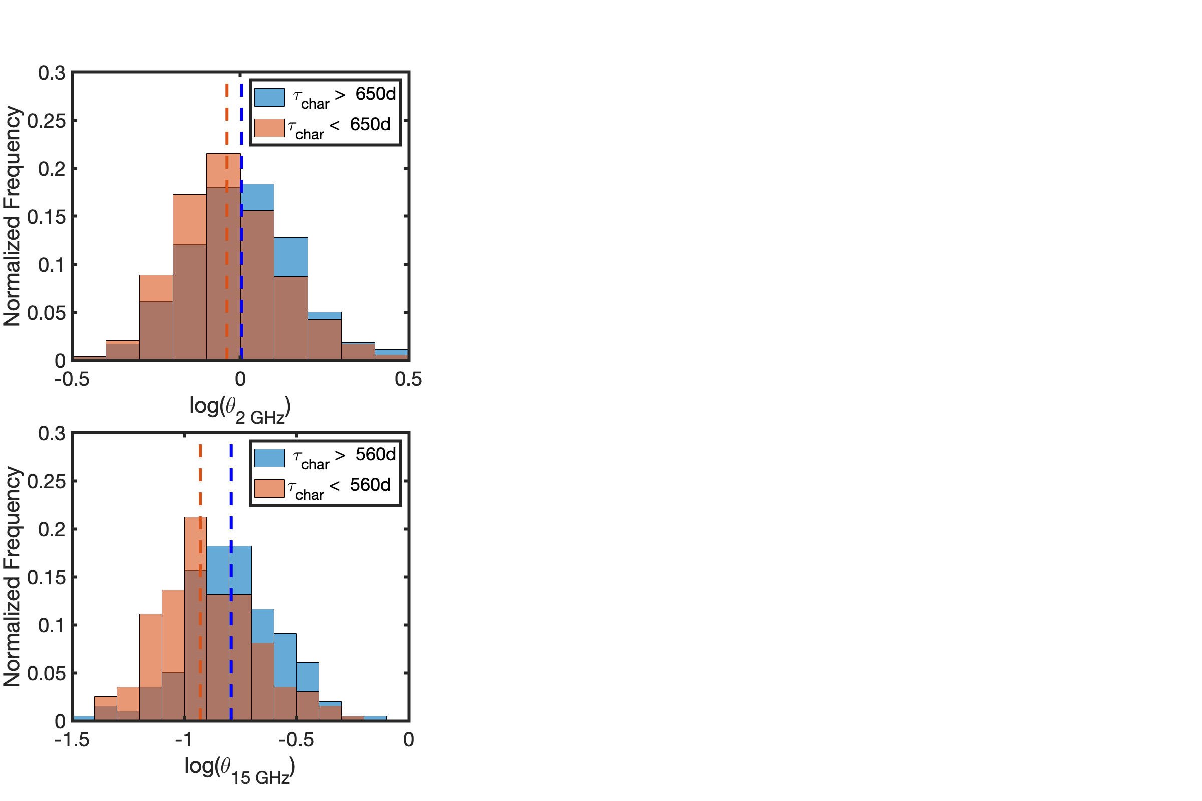
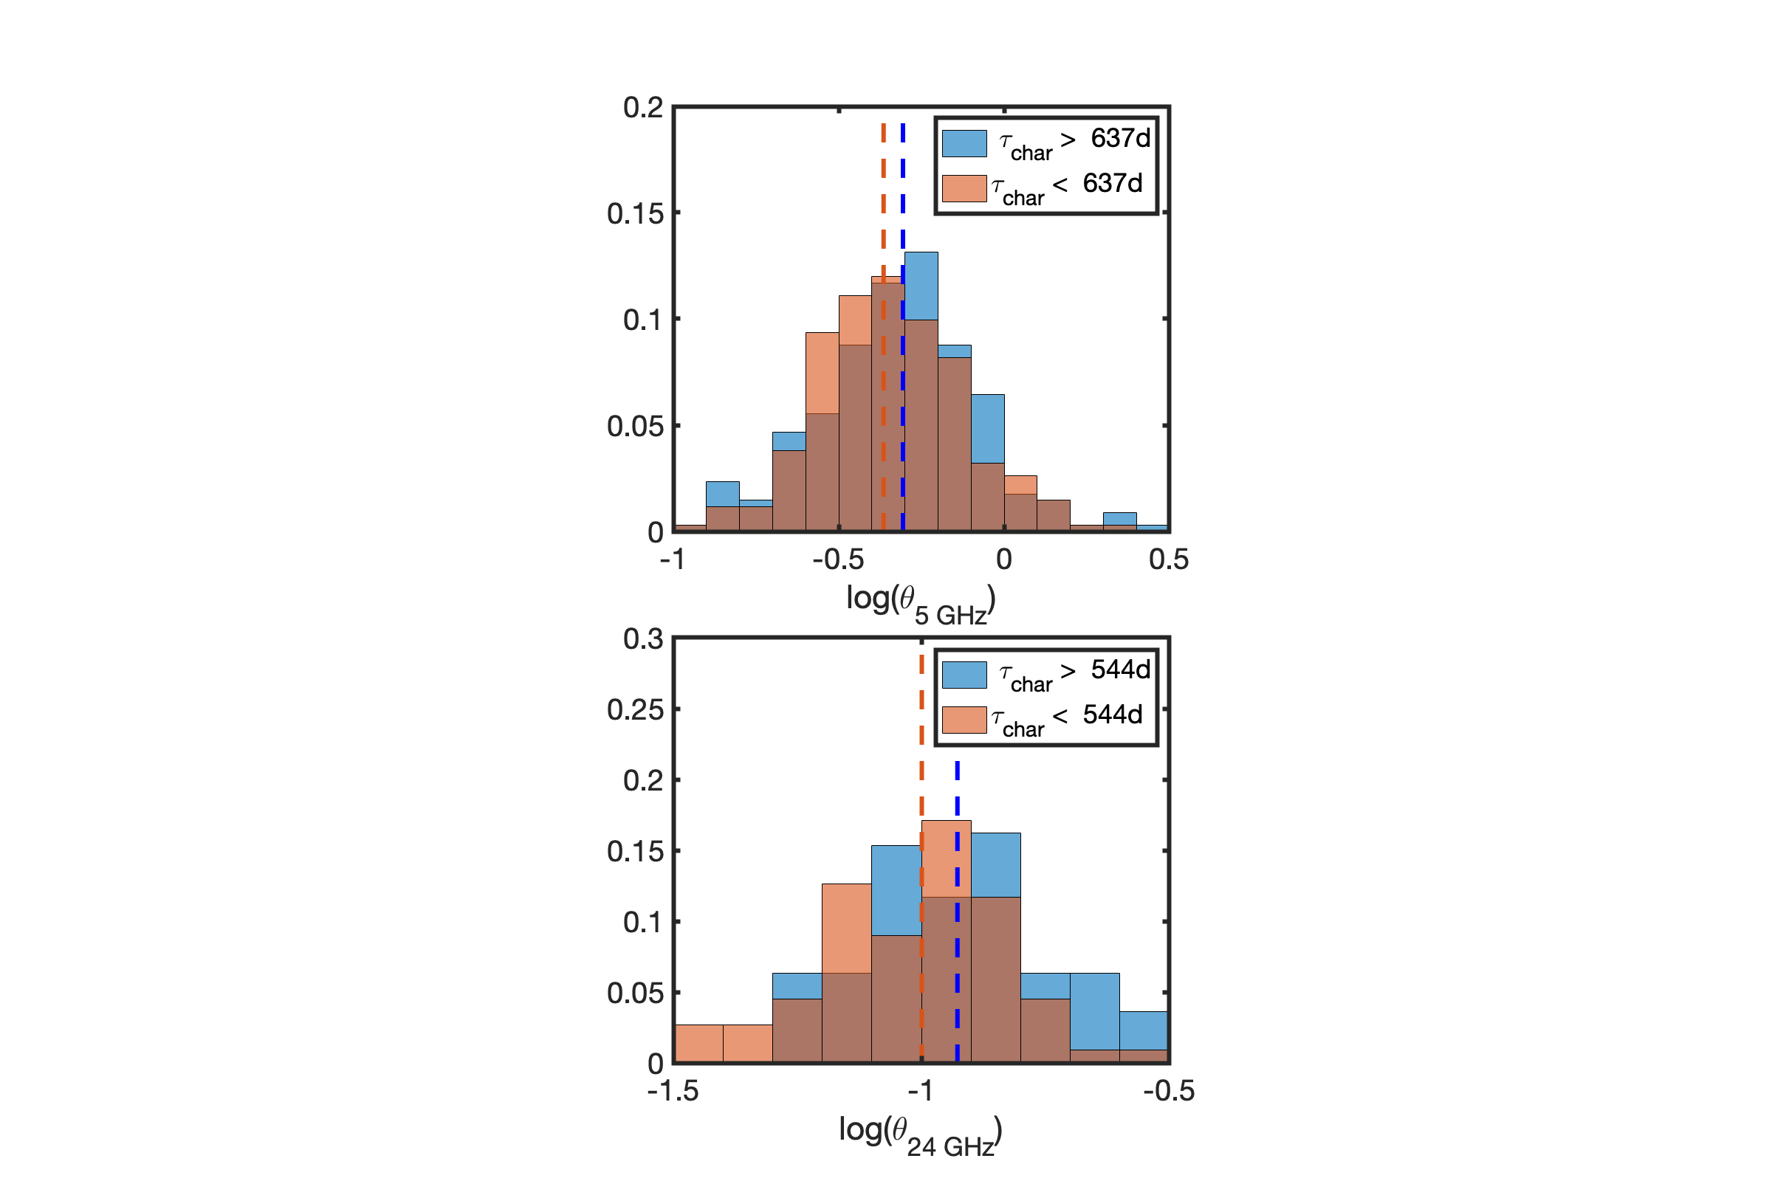










Dependence of Characteristic Timescale ($τ_{char}$) on Angular Core Sizes
$$\#=1053$$
$$p =1.07×{10}^{−4}$$
$$\#=965$$
$$p=4.72×{10}^{−4}$$
$$\# =464$$
$$p =1.78×{10}^{−1}$$
$$\#=1053$$
$$p =1.07×{10}^{−4}$$
$$\#=376$$
$$p =2.33×{10}^{−6}$$
$$\#=156$$
$$p =4.52×{10}^{−2}$$
$$\#=158$$
$$p =6.33×{10}^{−2}$$
$$\#=376$$
$$p =2.33×{10}^{−6}$$
Notes:
On the other hand,
for the relationship between intrinsic timescale and linear core sizes, w
e are still in progress of working on using redshift and Doppler boosting factor of it

Slide 10



correlation test | $$r$$ | $$p$$
$$D\left(1000 d\right) v.s. θ_{obs, 2 GHz}$$ | $$−0.1451$$ | $$1.82×{10}^{−5}$$
$D\left(1000 d\right) v.s. l_{obs, 2 GHz}$ | $$−0.1066$$ | $$3.10×{10}^{−3}$$
Two sample K-S test | $$p$$
$θ_{obs, 2 GHz}$ of strong and weak variables | $$1.83×{10}^{−2}$$
$l_{obs, 2 GHz}$ of strong and weak variables | $$3.52×{10}^{−2}$$
$θ_{obs, 2 GHz}$ of fast and slow variables | $$4.72×{10}^{−4}$$ | $$4.72×{10}^{−4}$$
Koryukova et al., 2022
Koryukova et al., 2022
Notes:
In the previosu slides, we discovered that low frequency core sizes usually have weaker correlation and p value in statistical tets
We think this is due to core size broadening of ISM, especially in low frequency regime
Koryukova et al., 2022 found that low frequencies core sizes will be significantly broadened in low galactic latitude region, in which there are a lot of ISM
For this figure, color bar shows average core sizes in the given pixel.
low galactic latitude region, as well as high density ISM region, the color become redder
For this figure, absolute value of galactic latitude within 10 degree, core sizes are significantly larger compare with those outside of that region

Slide 11










Multifrequency fitting of Observe Core Sizes (Koryukova et al., 2022)
Highly scattered source (e.g., J0359+5057)
$k_{int}=1;k_{sca}=2$
Undetected scattering source (e.g., J0433+0521)
$k_{obs}=1$
$$θ∝ν^{−k}, \left\{\begin{aligned}scattering, k=2 \\ intrinsic, k=1\end{aligned}\right.$$
$$k_{sca}=2.01±0.13$$
$$k_{sca}=2$$
Using core sizes ($θ_{Ang}$ and $θ_{sca}$) at other frequencies from Koryukova et al. (2022)
derive $θ_{int, 1 GHz}$ and $θ_{sca, 1 GHz}$
$$k_{obs}=1$$
Convolution relationship of core sizes
$$θ_{Ang}^{2}=θ_{int}^{2}+θ_{sca}^{2}$$
$$θ_{int}=θ_{int, 1 GHz}ν^{−k_{int}}, k_{int}=1$$
$$θ_{sca}=θ_{sca, 1 GHz}ν^{−k_{sca}},k_{sca}=2.01±0.13$$
$$k_{int}=1$$
Koryukova et al. (2022)
2
5
8
15
Notes:
So nest, we would like to extract the intrinsic core sizes, by deconvoluing scattering core sizes
In conical jet model, observed core size and observed frequency have a power law relationship

Slide 12






Dependence of Long Term Variability Amplitudes on
1 GHz Intrinsic/Scattering/Angular Core Sizes
$$θ_{Ang}^{2}=θ_{int}^{2}+θ_{sca}^{2}$$
$$N=538$$
$$r=−0.2915$$
$$p=5.34×10^{−12}$$
$$N=538$$
$$r=−0.2915$$
$$p=5.34×10^{−12}$$
$$N=230$$
$$r=0.0661$$
$$p=3.18×10^{−1}$$
$$N=538$$
$$r=−0.0669$$
$$p=1.21×10^{−1}$$
Notes:
after remove scattering core sizes from observed one, we get intrinsic core sizes, and intrinsic core sizes show significant correlation with SF amplitudes at 1000 days
If we separate core sizes into strong and weak distribution, we still get the same conclusion

Slide 13






Dependence of Short Term Variability Amplitudes (Scintillation) on 1 GHz Intrinsic/Scattering/Angular Core Sizes
$$θ_{Ang}^{2}=θ_{int}^{2}+θ_{sca}^{2}$$
$$N=538$$
$$r=−0.2104$$
$$p=8.48×10^{−7}$$
$$N=538$$
$$r=−0.2104$$
$$p=8.48×10^{−7}$$
$$N=538$$
$$p=1.96×10^{−8}$$
Notes:
SF fitting is dominated by noise at small time lags, and are derive from SF equatioon
short term variability is cause by ISM scintillation
scintillation is correlated with source intrinsic core size,
source with small core size have larger scintillation effect than larger core sizes sources

Slide 14

Conclusions
Significant negative correlation are found between 15 GHz $D(1000 d)$ and linear core sizes at 2-24 GHz, likely due to frequency-core sizes relationship, e.g., conical jet model (Ghisellini &. Tavecchio, 2009)
Fast variable sources have significantly smaller angular core sizes at 2-43 GHz than slow variables sources, due to light travel time argument
Correlation at low frequencies is weaker likely due to contamination of the angular core size from ISM scattering
Using only intrinsic core size (after deconvolving scattered size), significant correlation was found between 15 GHz $D(1000 d)$and 1 GHz intrinsic core sizes
For the 15 GHz $D\left(4 d\right)$, intrinsic and scattering core sizes display significant correlation

Slide 15
Acknowledgment
This research has made use of data from the OVRO 40-m monitoring program (Richards, J. L. et al. 2011, ApJS, 194, 29), supported by private funding from the California Institute of Technology and the Max Planck Institute for Radio Astronomy, and by NASA grants NNX08AW31G, NNX11A043G, and NNX14AQ89G and NSF grants AST-0808050 and AST- 1109911.
and
Special thanks to IAUS 375 for giving this opportunity to present the results : )
Notes:
I personally thank Dr. Koay for advising me
We thank the OVRO team for providing the data to do the study
last I would like to thank the IAUS 375 for providing the opportunity to give the presentation : )

